Slide 1

Predicting Forest Fires in Algeria Using Machine Learning
A Machine Learning Project
Name : Sanji krishna M P
Roll No : 240801299
College : Rajalakshmi engineering college
ROLL:240801299

Slide 2
Introduction: Project Overview
1
2
3
Problem Statement
Motivation & Significance
Objectives
Predicting forest fires in Algeria using a dataset from two regions: Bejaia and Sidi Bel-abbes.
Forest fires pose significant environmental and economic threats, making accurate prediction crucial for prevention.
To develop an ML model capable of predicting the Fire Weather Index (FWI) with high accuracy.
ROLL:240801299

Slide 3

Dataset Overview
1
The dataset comprises 244 instances, with 122 instances from each region: Bejaia (northeast) and Sidi Bel-abbes (northwest) of Algeria.
2
Data was collected from June 2012 to September 2012. It includes 11 input attributes and 1 output attribute (class).
3
The instances are classified into two categories: fire (138 classes) and not fire (106 classes).
Dataset Source: Kaggle
ROLL:240801299

Slide 4






Methodology: Project Workflow
Dataset Cleaning
Initial processing to handle missing values and inconsistencies.
Data Analysis
Exploratory data analysis to understand patterns and relationships.
Feature Selection
Identifying the most relevant attributes for model training.
Model Selection
Choosing appropriate machine learning algorithms for prediction.
Hyperparameter Tuning
Optimising model parameters for best performance.
Evaluation
Assessing model performance using key metrics.
ROLL:240801299

Slide 5
Data Collection & Preprocessing
Preprocessing Steps :
Cleaning: Handling missing values and outliers.
Feature Engineering: Creating new features from existing ones.
Normalization: Scaling data to a standard range for model compatibility.
Exploratory Data Analysis.
ROLL:240801299

Slide 6




Model Selection & Training
Model Selection
Training Process
Choosing the right ML algorithm suitable for predicting FWI, balancing classification and regression needs.
Training the selected model on the preprocessed data, with iterative refinement and validation for optimal learning.
Hyperparameter Tuning
Evaluation Metrics
Systematically adjusting model parameters to optimize performance and prevent overfitting.
Measuring performance using accuracy, precision, recall, F1-score (classification), and RMSE/MAE (regression).
ROLL:240801299

Slide 7
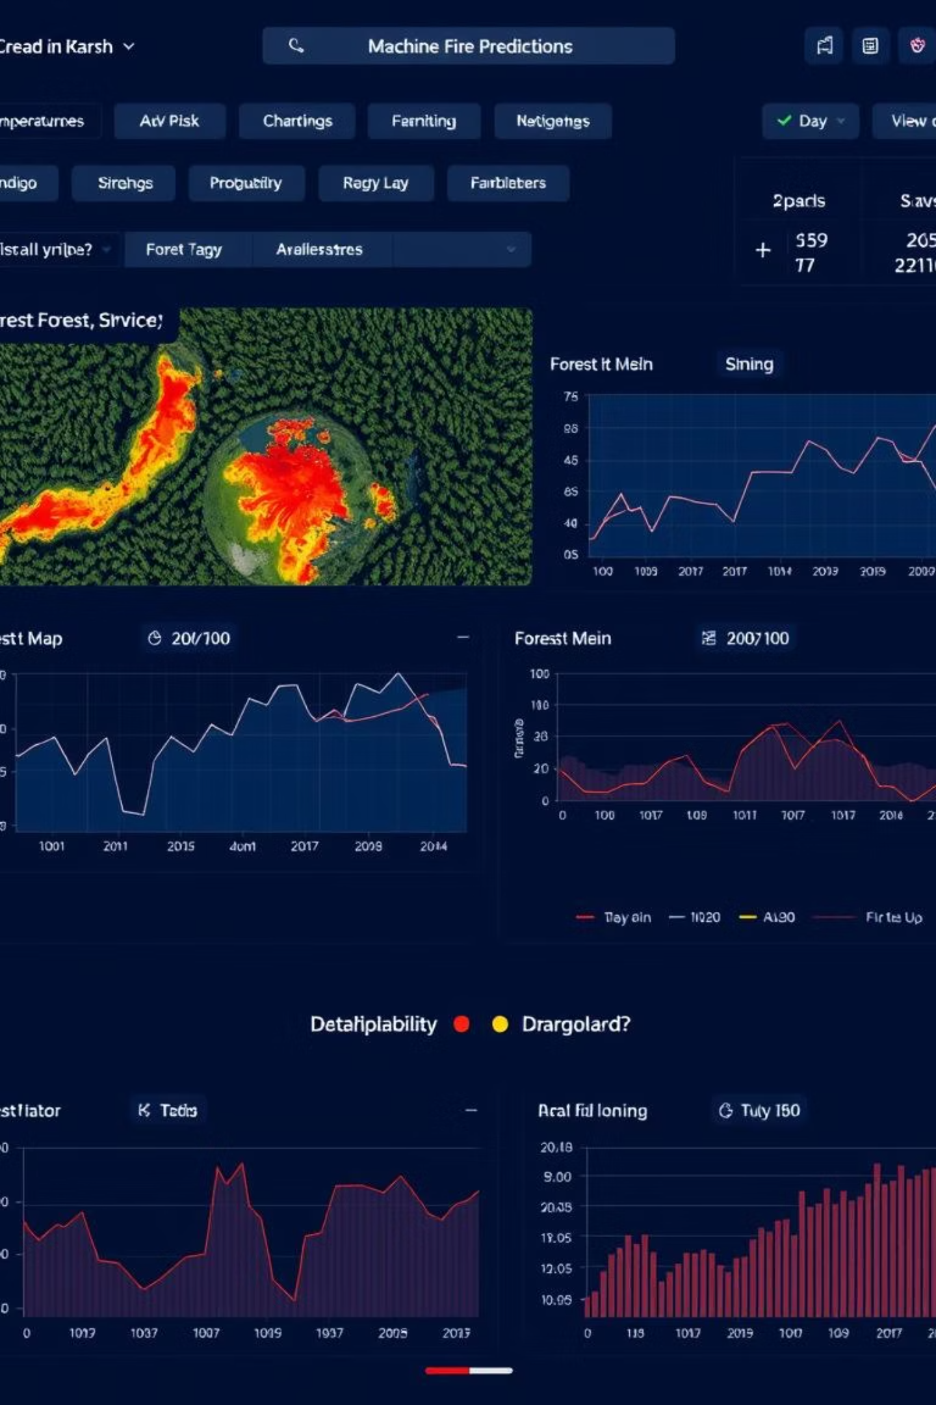
Results & Analysis: Key Findings
Our machine learning model achieved exceptional performance in predicting the Fire Weather Index (FWI), demonstrating its robust capability in identifying fire danger.
98.54%
Accuracy
Overall accuracy of the model in predicting fire and non-fire instances.
This high level of accuracy highlights the model's strong potential for real-world application in forest fire prevention efforts.

Slide 8
Challenges & Solutions
Feature Correlation
Model Overfitting
Challenge: Highly correlated features impacting model performance.
Challenge: Model performing well on training data but poorly on new data.
Solution: Utilised feature selection methods to reduce multicollinearity.
Solution: Implemented regularisation and cross-validation techniques.
ROLL:240801299

Slide 9
Conclusion & Future Work
Summary of Achievements
Future Work
Our ML model successfully predicts the Fire Weather Index with an accuracy of 98.5382%, addressing the problem of forest fire prediction effectively.
Incorporate real-time weather data for dynamic predictions.
Explore deep learning models for enhanced accuracy.
Limitations
Expand dataset to include more regions and longer timeframes.
The model's performance is limited by the scope and period of the dataset (June-September 2012).
Develop a user-friendly interface for practical application.
ROLL:240801299

Slide 10

Thank You!
ROLL:240801299

